Slide 1
FP-Growth Algorithm
حسين علي إبراهيم الشامي

Slide 2
FP-Growth
allows frequent itemset discovery without candidate generation. Two step:
1.Build a compact data structure called the FP-tree
Only 2 passes over the database
2.Extracts frequent item sets directly from the FP-tree
Traverse through FP-tree

Slide 3
Steps:
Scan DB once, find frequent 1-itemset (single item pattern)
Sort frequent items in frequency descending order, f-list
Scan DB again, construct FP-tree

Slide 4
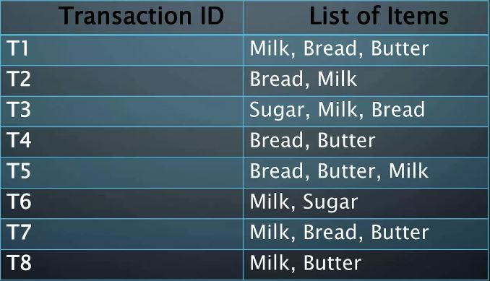
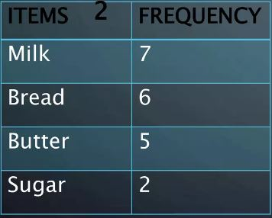
Example
First we find the most frequent items, then get rid of the items with less than the minimum support

Slide 5
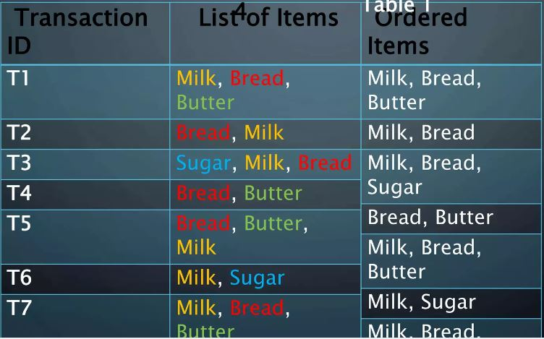
Example
Then we create a table with the items order based on their frequency

Slide 6
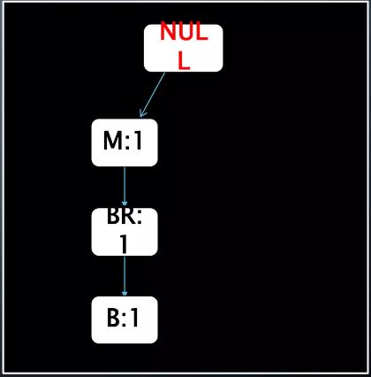
Example
Now we can construct the tree

Slide 7
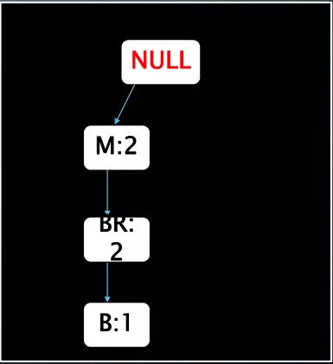
Example
Now we can construct the tree

Slide 8
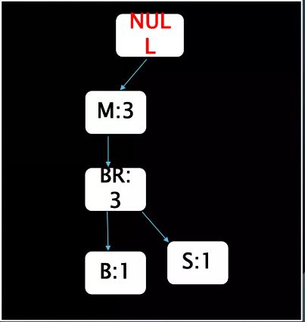
Example
Now we can construct the tree

Slide 9
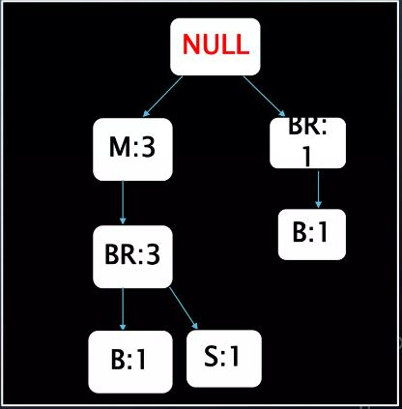
Example
Now we can construct the tree

Slide 10
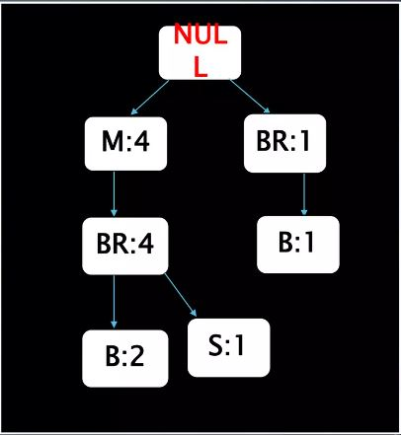
Example
Now we can construct the tree

Slide 11
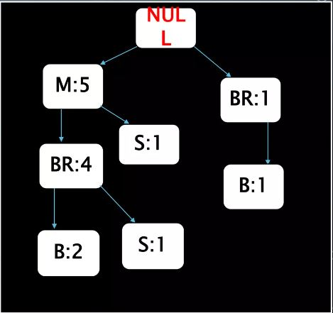
Example
Now we can construct the tree

Slide 12
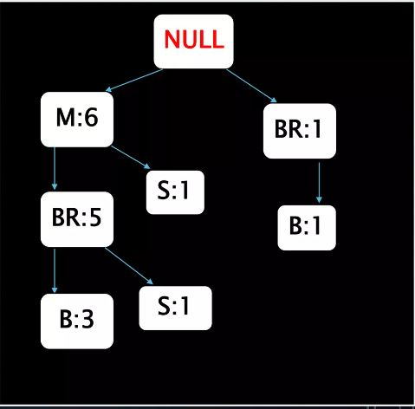
Example
Now we can construct the tree

Slide 13
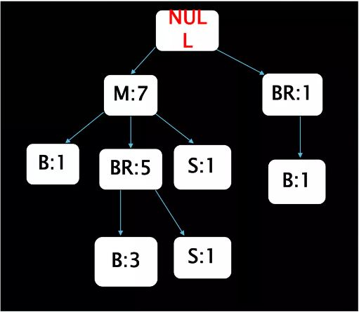
Example
Now we can construct the tree

Slide 14
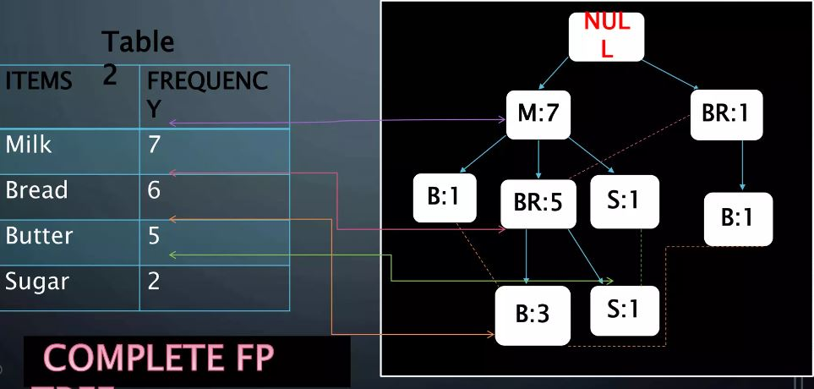
Final Result

Slide 15
​Item | Conditional Pattern Base | Conditional FP Tree​ | Frequent Patterns Generated
Sugar | {{M:1},{M,BR:1}} | ​{M:2} | {<S,M:2>}
Butter | {{M:1},{M,BR:3}} | {M:4} | {<B,M:4>}
Bread | {{M:5}}​ | {M:5} | {<BR,M:5>} | ​
Milk | None​ | None | {}

